Slide 1
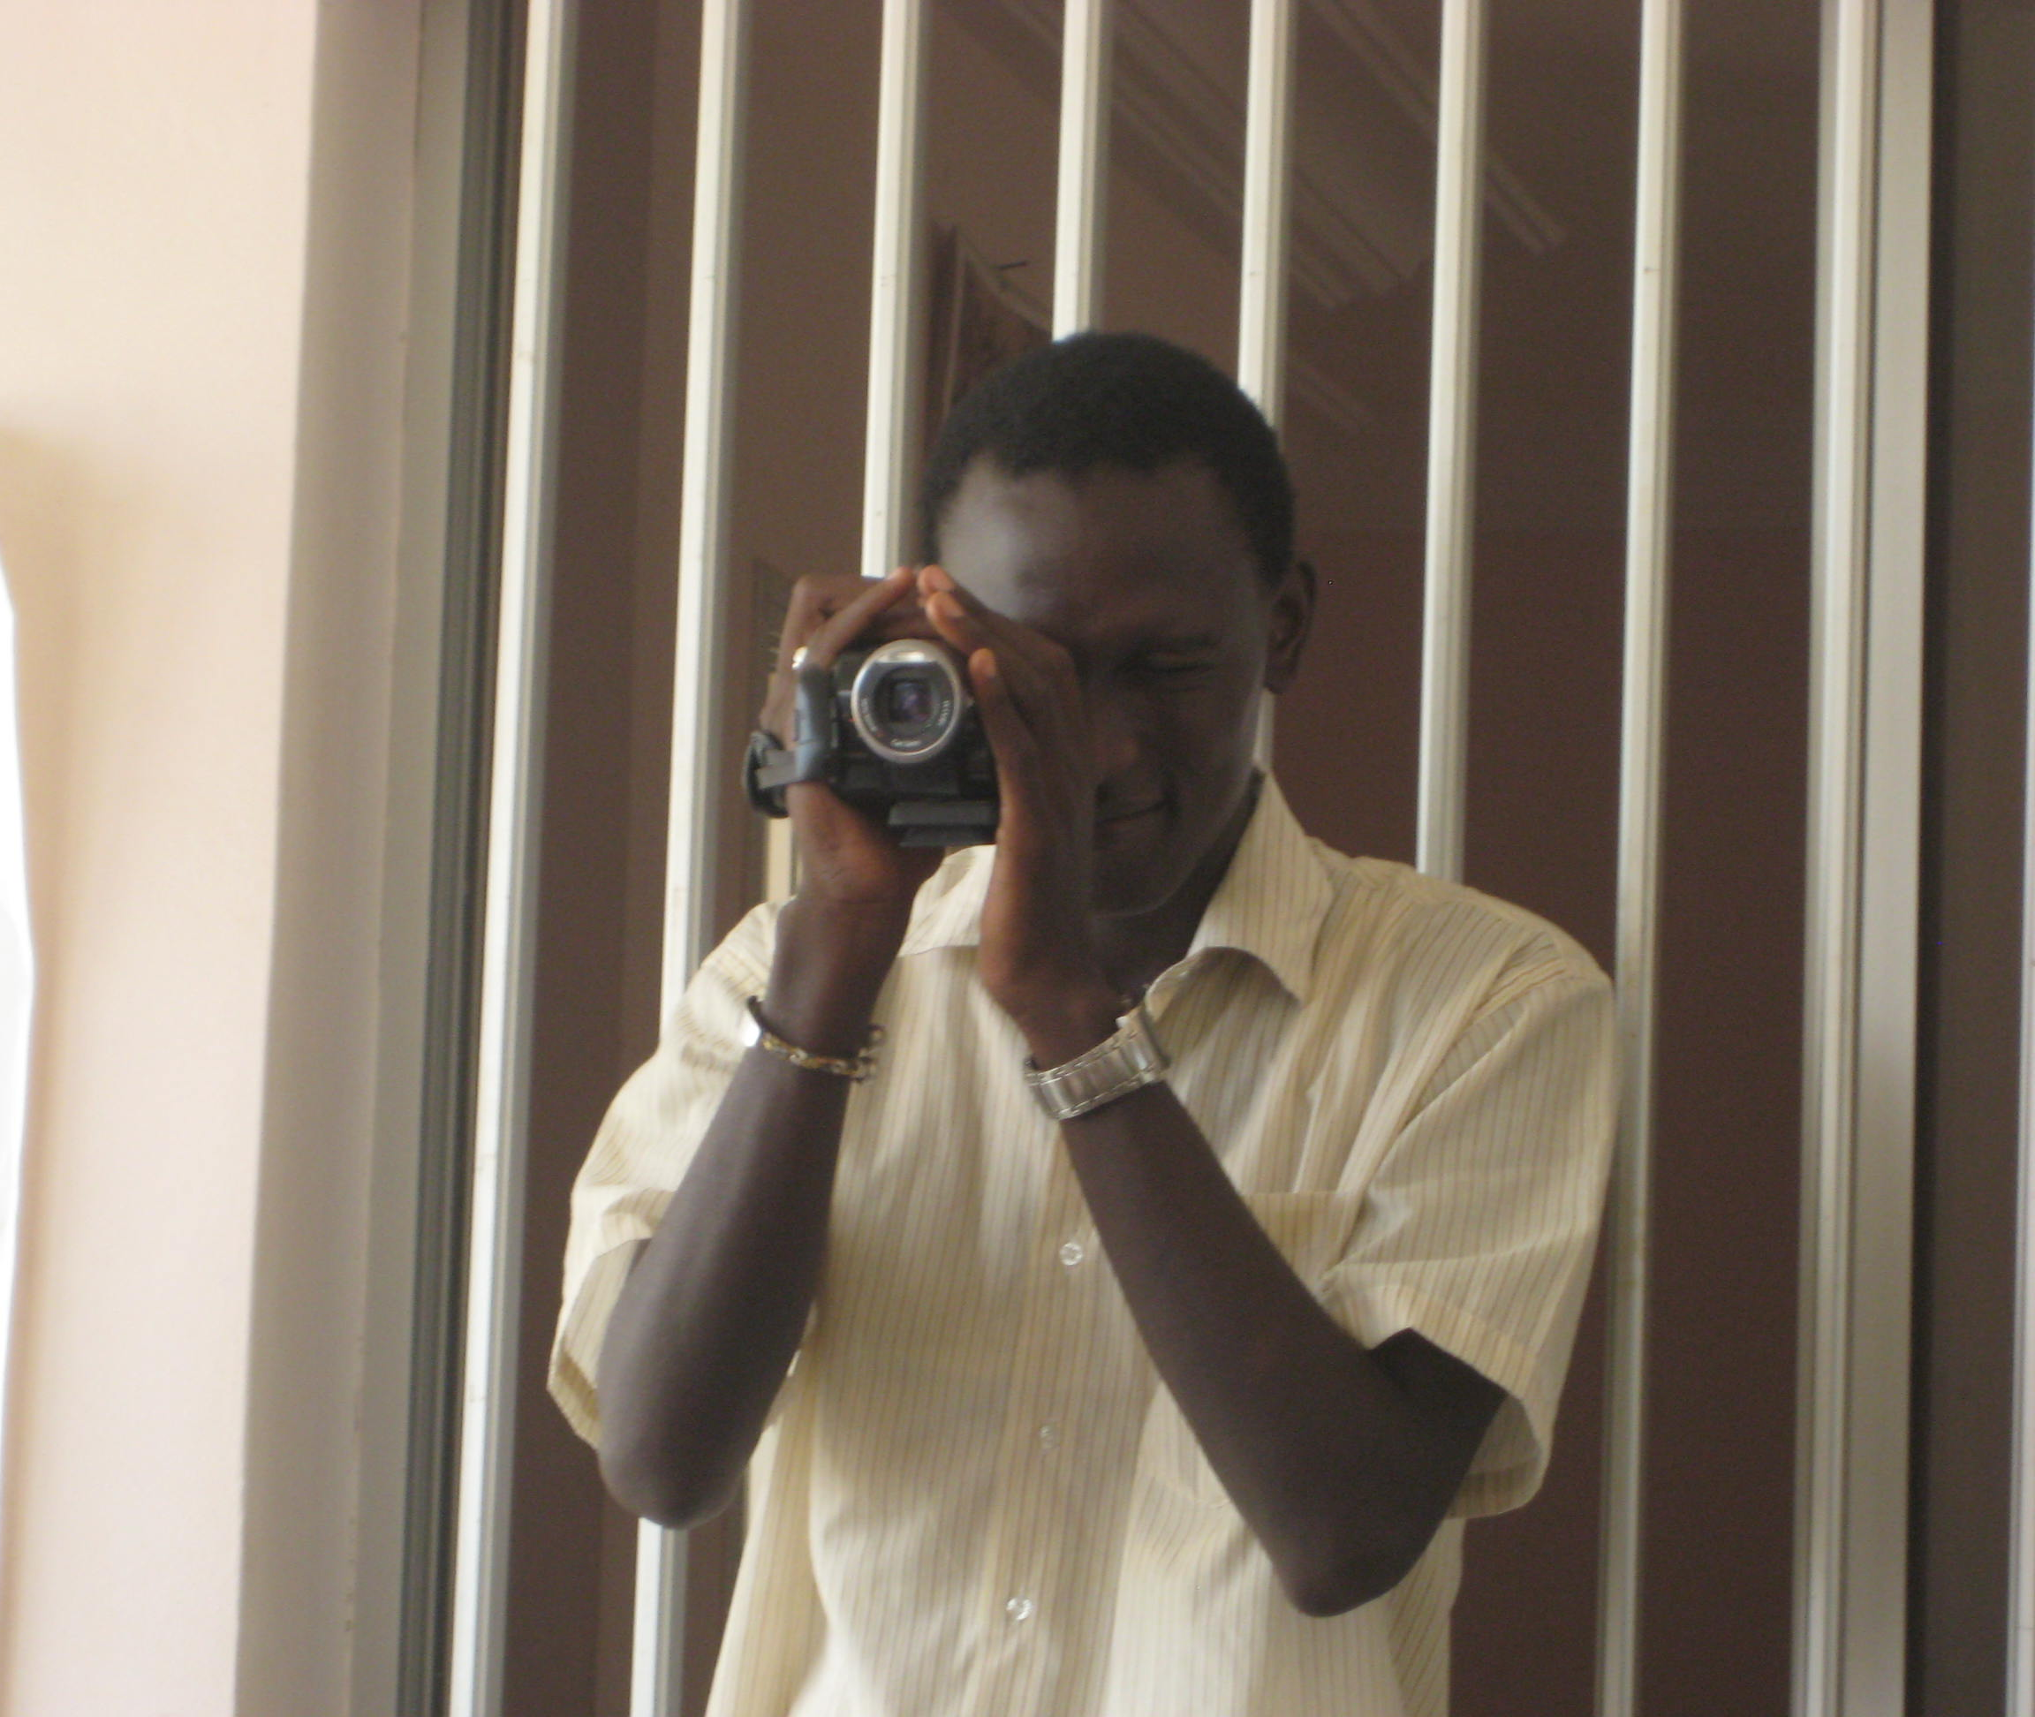
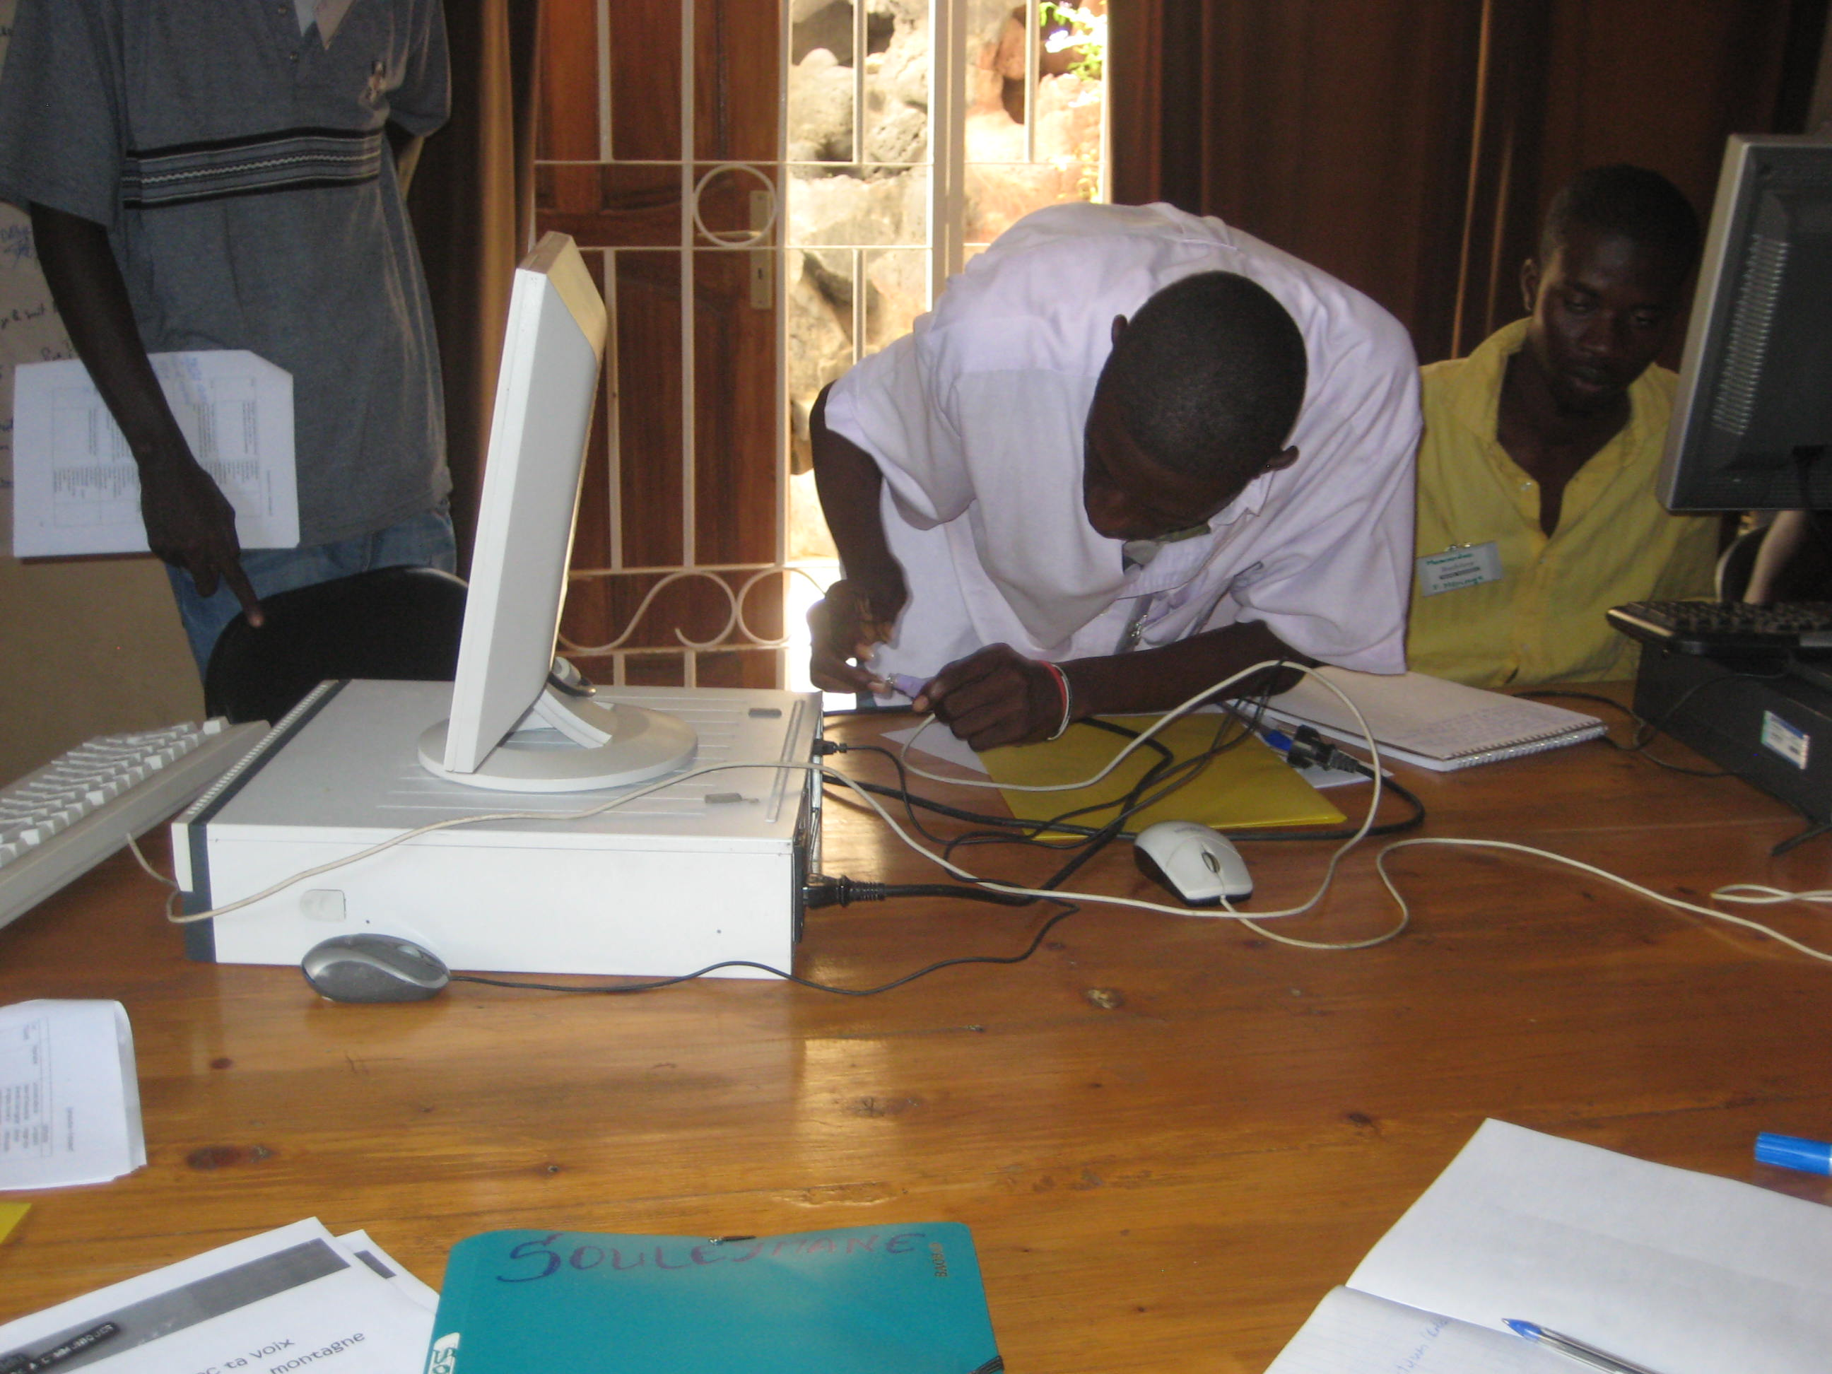
Our Voices: Communication & Collaboration From the Inside Out
Laurel Felt felt@usc.edu

Slide 2
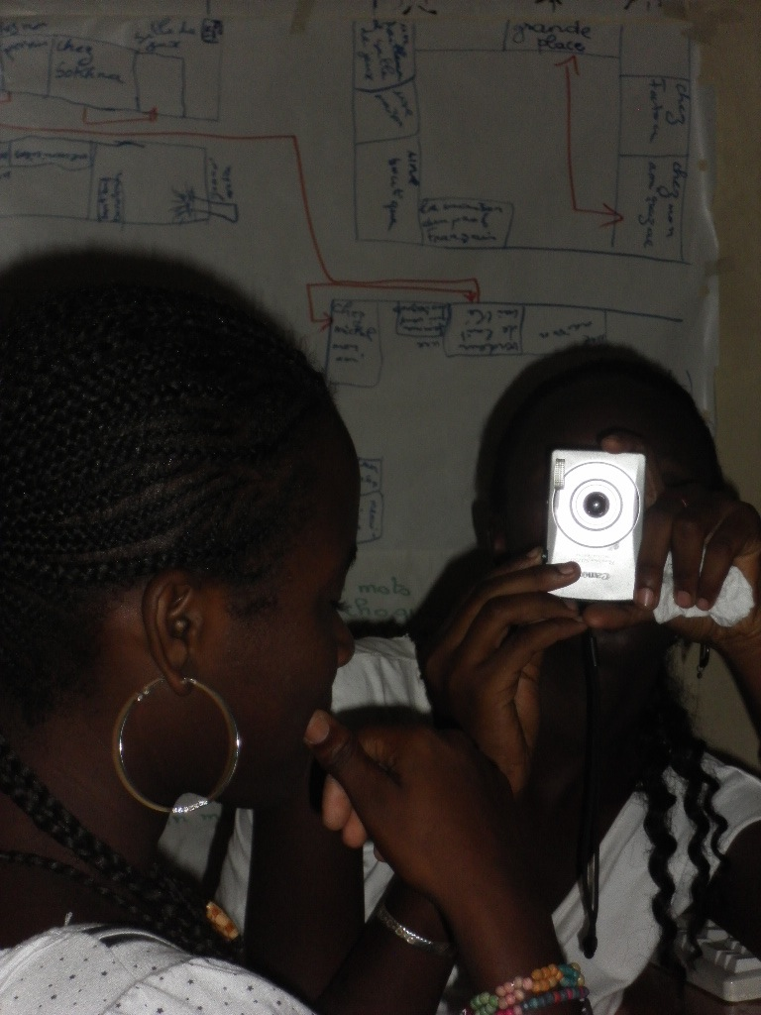
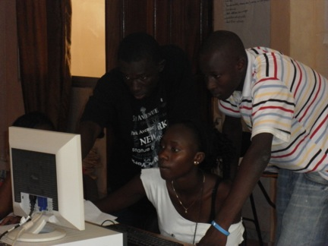
Sunukaddu: Communication
Notes:
-- case study in applying theory to practice
-- teens in Dakar learned how to communicate effectively via formal instruction in understanding one’s objectives, audience, and environment, crafting and disseminating messages accordingly, and harnessing multiple techniques, such as journalism and entertainment, and modalities, such as conversation, graphic design, print, audio, video, online

Slide 3
Connection
Notes:
-connect local technology with classroom practice for intuitive models, metaphors supportive of rich comprehension, application
-connect Dakar and Los Angeles

Slide 4
Collaboration: Benefits
-Wider, richer community
-Diverse linguistic opportunities
-Mirror & window
-Entry point for further inquiry
Notes:
-- access to a second community, allowing for visibility of work, comparing, contrasting, inspiring, commenting, collaborating, relationship building → in NML terms, play, networking, negotiation, collective intelligence, transmedia navigation
-- opportunity to expand linguistic skills: language -- French (or Wolof!) for RFK students, English (or Spanish, etc) for Sunukaddu-ites, pragmatics – turn-taking, perspective-taking – complicated by cyber and intercultural communication contexts, and nonlexical languages, such as visual art (graphic design), music (beats), and audio-visual (editing, remix)
-- opportunity to better appreciate similarities and differences across cultures and communities
-- exciting, concrete entry point into studies of geography, history, politics, and development

Slide 5
Collaboration: Framework
-Wiki posts
-Skype, IM chats
-Joint projects
-Parallel projects
-Meetings abroad
Notes:
-- participants from RFK and Sunukaddu contribute to a shared Wiki (curricula, documentation of process, reflection, “finished” products)
-- could have regular Skype or IM sessions
-- could plan final projects that function as joint (e.g., one RFK student, one Sunukaddu-ite) or parallel (e.g., “sister cities” approach, doing precisely the same thing simultaneously)
-- grants for staff and/or participants to present at international conferences (pedagogical, technological, health, youth-oriented) or visit one another

Slide 6
Social & Emotional Learning (SEL)
Notes:
-- form the individual, set the stage for living with yourself and others -- list and barely explain 5 SEL competencies: self-awareness, self-management, social awareness, relationship skills, and responsible decision-making.

Slide 7
Asset Appreciation
Notes:
recognize what you’ve got – intrapersonal AND interpersonal -- and optimize
consider every level: nano, micro, meso, macro which means intrapersonal, intimate circle, local community, broader society

Slide 8
Narrative
Notes:
The power of narrative…
-- stories as robust educational tool (entertainment-education)
AND
-- _the stories we tell ourselves_
-- Theory of possible selves contends that people are motivated by visions of the person they could become if they make good choices, and the person they could become if they don’t make good choices
-- if you only tell yourself that you’re going to be the best, then you become cocky and flabbergasted, lost when the road gets bumpy
-- if you only tell yourself that you’ll amount to nothing, then you become defeated and unable to seize opportunities that might present themselves
-- so the stories we tell ourselves about who are and who we could be, to a certain extent, circumscribe our trajectories
(-- stories are also essential to humanity and are the means by which we assimilate information – we tell a story about it; that’s how we understand, that’s how we remember)

Slide 9
New Media Literacies (NMLs)
Notes:
-- SEL skills are pre-requisites -- form the learner, set the stage for meaningful learning via critical thinking, problem-solving, and collaboration. -- They're not about technology. They're about enriching learners with useful, versatile capacities that help them think sharper, work better, and appreciate fuller the ethical ramifications of their actions. -- (list but do not explain 12 NML’s: play, performance, simulation, appropriation, multitasking, distributed cognition, collective intelligence, judgment, transmedia navigation, networking, negotiation, visualization)]

Slide 10
Model

Slide 11
Impacts: From the Inside Out
Notes:
Self-awareness
- To discover my skills and my potential
The courage to express myself and overcome my shyness, complexes, and my fears
Self-management
- Self-management, especially in moments of anger
- Developing patience, concentration, motivation
Social awareness
- Increased sociability
Better understanding of others -- in general, conceptualizing what makes them tick, as well as better ability to read people in the moment
With these capacities, participants commented that they can develop and share messages more effectively
Relationship skills
New insights and tools for managing relationships, both personal and professional
Responsible decision-making
- Exercising judgment, valuing personal growth, maturity, and responsibility
Learning how to make choices and considering career paths

Slide 12
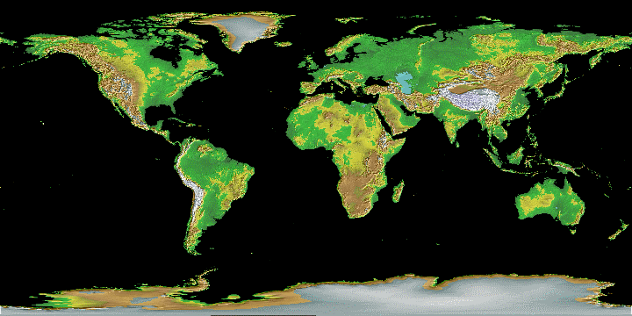
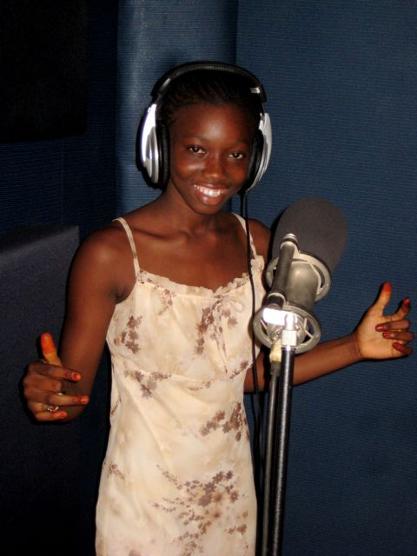
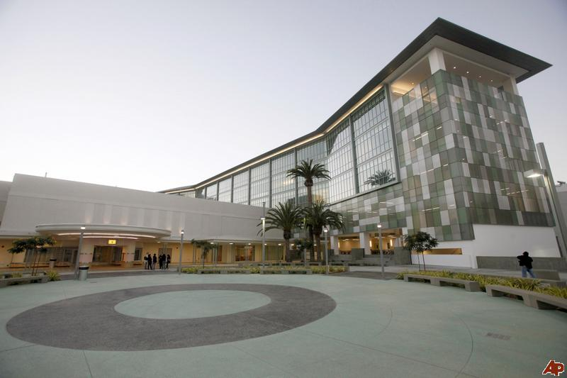
Community
Notes:
-writ large, what all of this implies is community – helping youths to regard their minds, their bodies, their schools, their neighborhoods, their world as rich, promising places to live – places with potential

